Slide 1
RESTFUL API DENGAN NODE.JS + EXPRESS.JS + MONGODB
Dikerjakan oleh:
Hafiza Rizky Irland
2 D4 IT A 3122600021

Slide 2
TOOLS
Express
Mongoose(ODM)
Dotenv
Nodemon
Postman

Slide 3
INSTALASI MODULE
npm init
npm install express

Slide 4
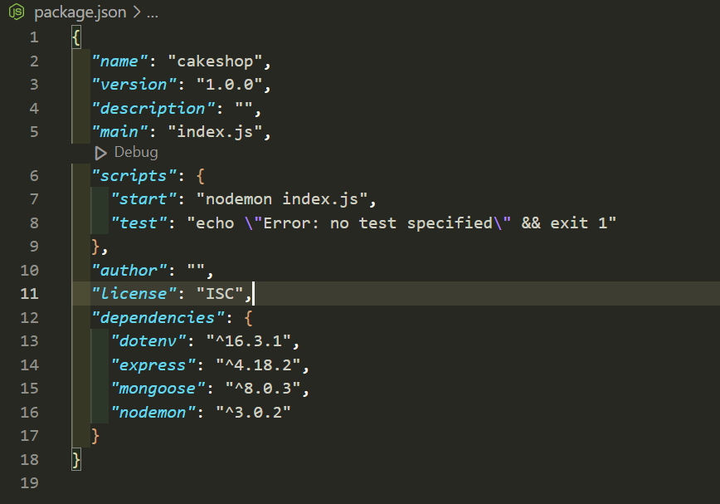
PACKAGE.JSON

Slide 5
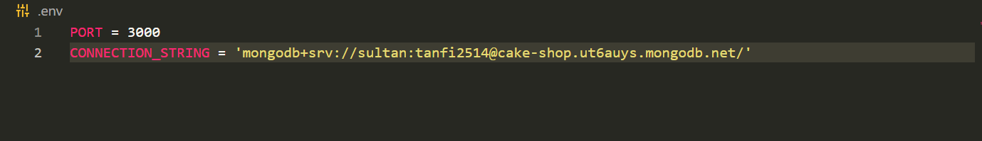
SETUP ENVIRONMENT

Slide 6
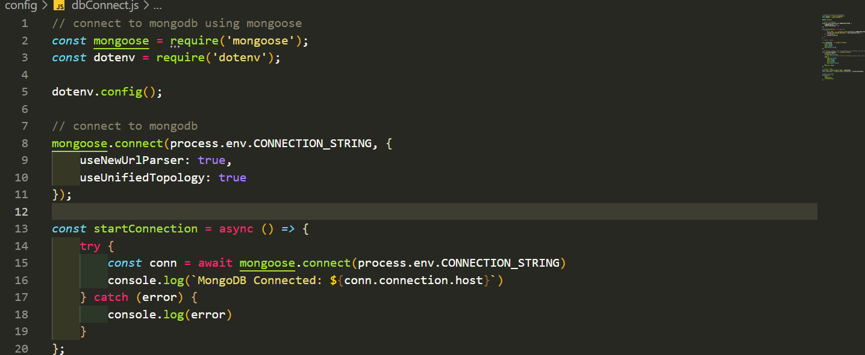
SETUP CONNECTION

Slide 7
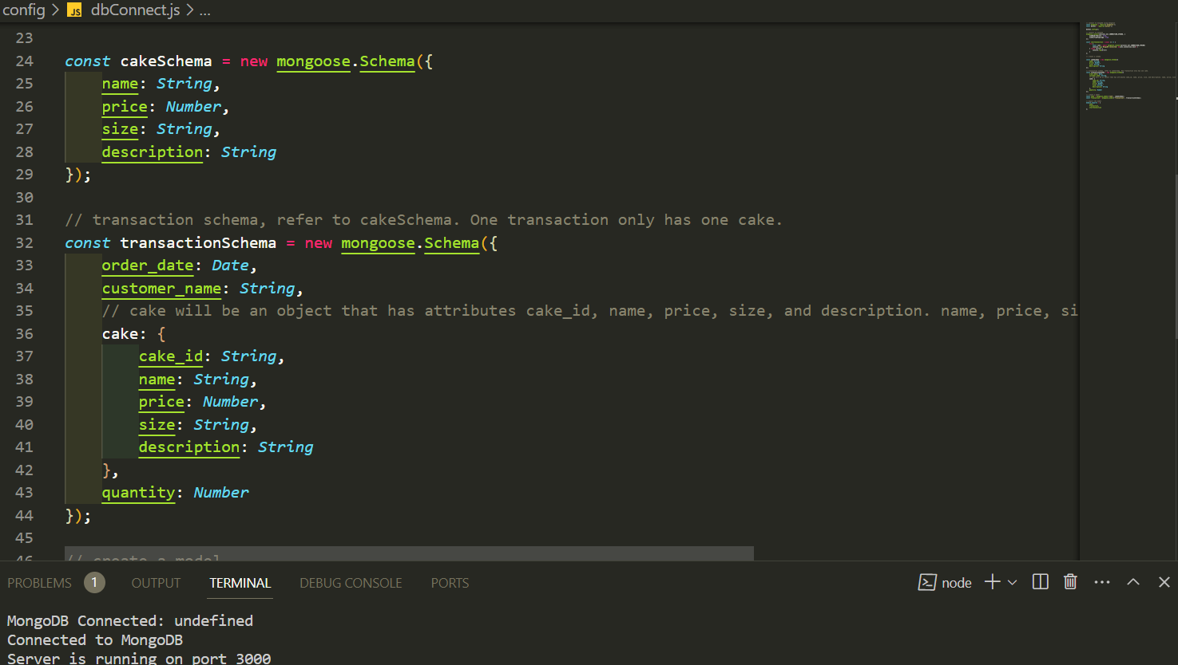
CREATE MODEL

Slide 8
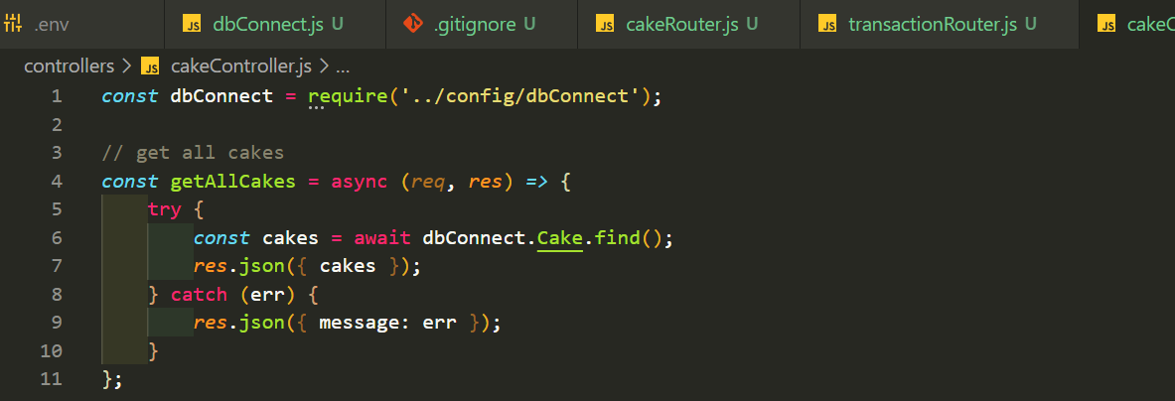
CREATE CONTROLLER

Slide 9
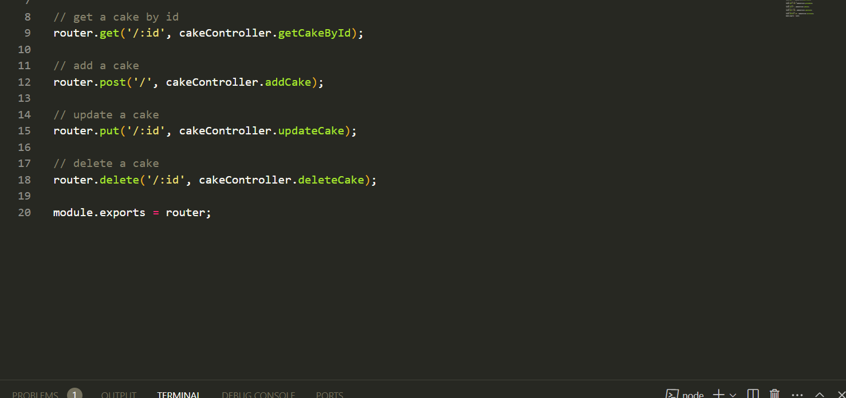
CREATE ROUTE

Slide 10
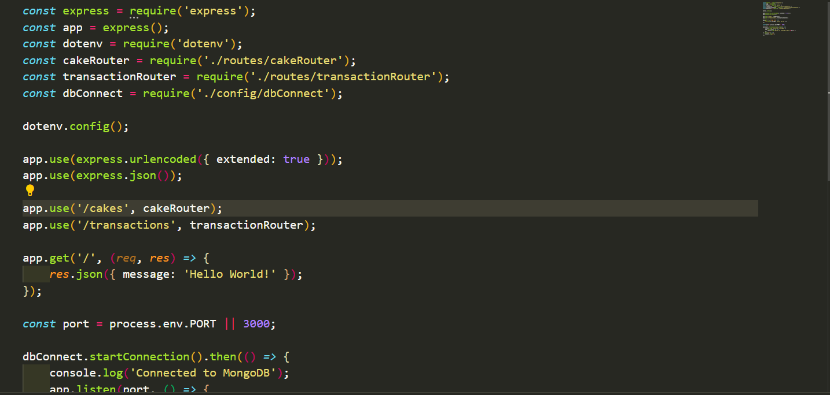
SETUP ENTRY POINT

Slide 11
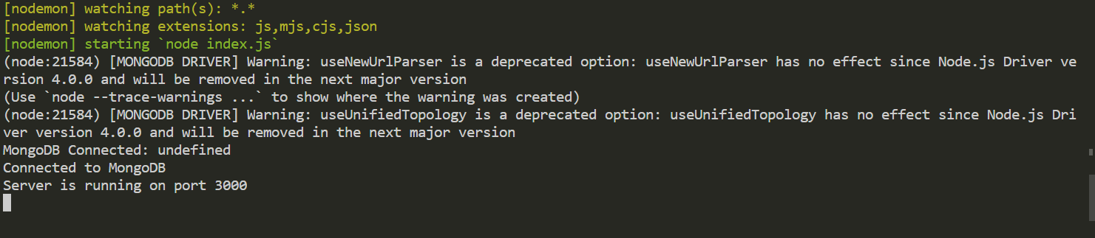
START SERVER

Slide 12
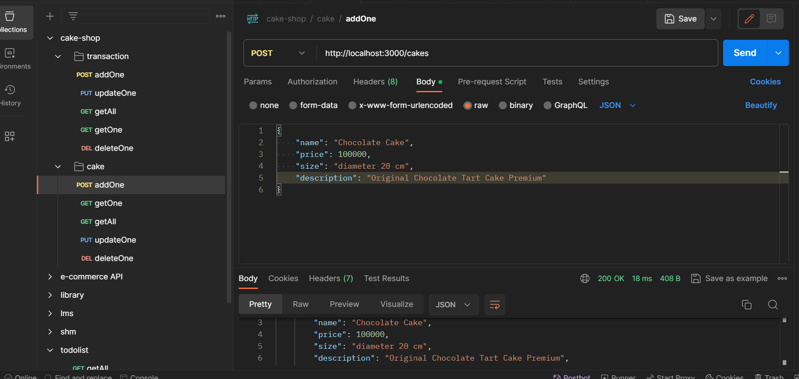
API TESTING ADD ONE CAKE

Slide 13
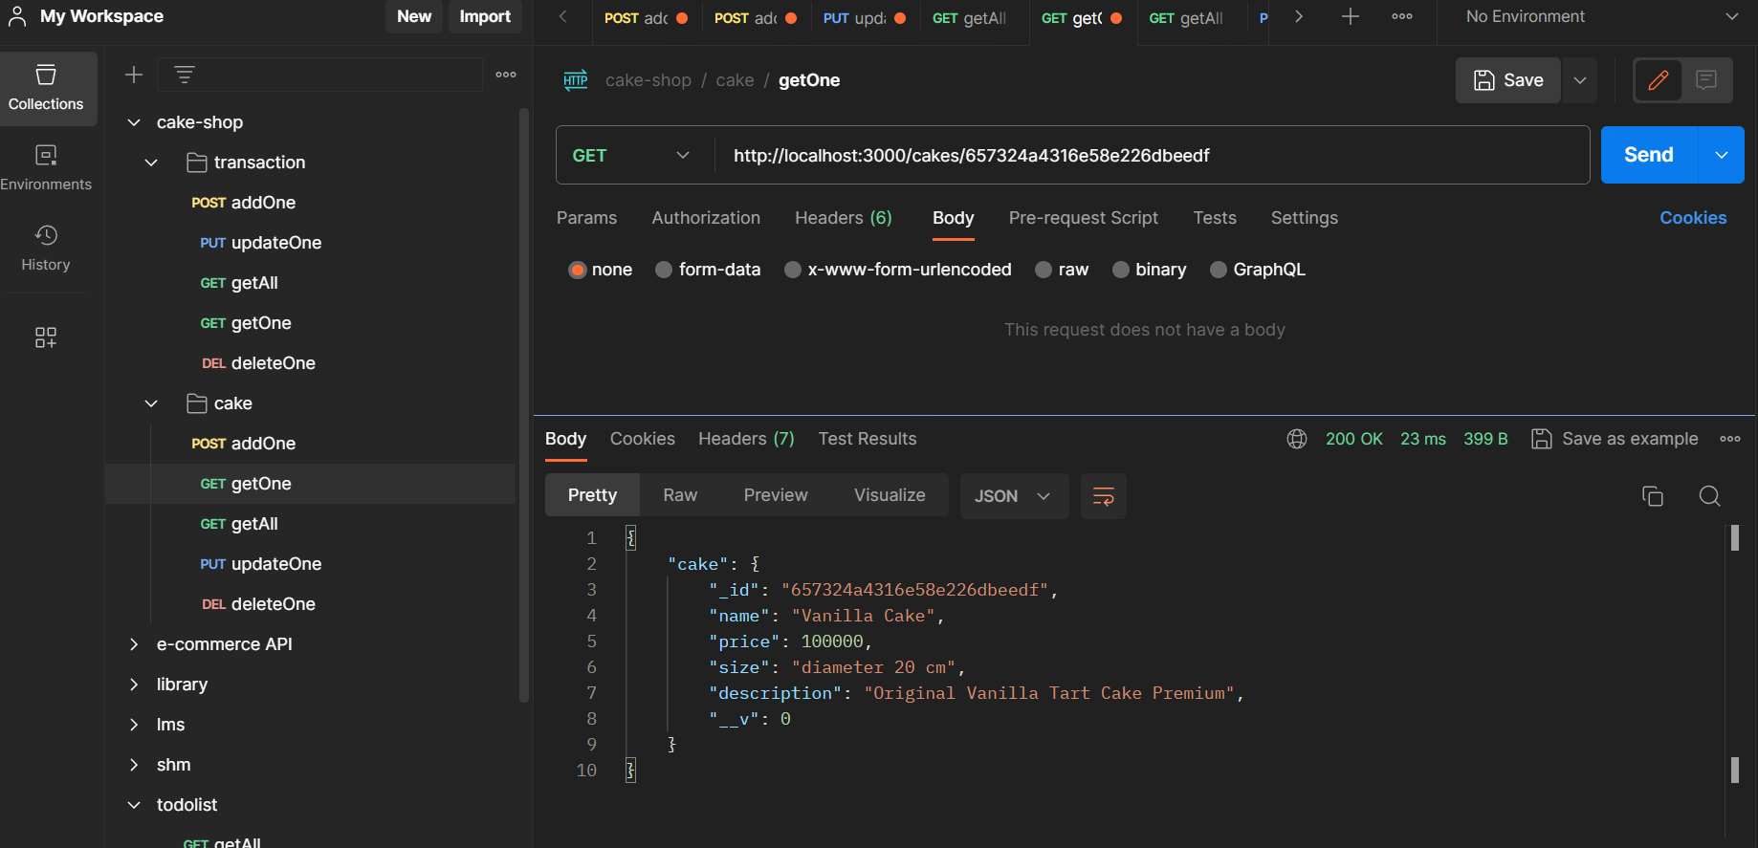
API TESTING GET ONE CAKE

Slide 14
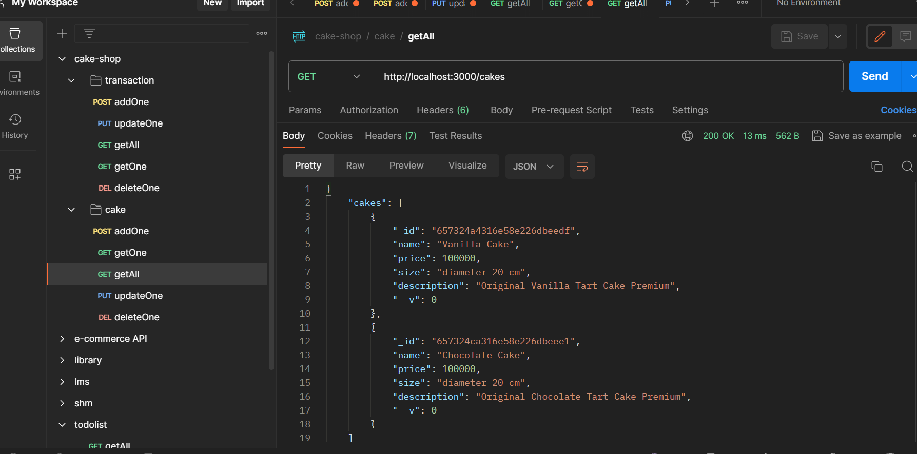
API TESTING GET ALL CAKES

Slide 15
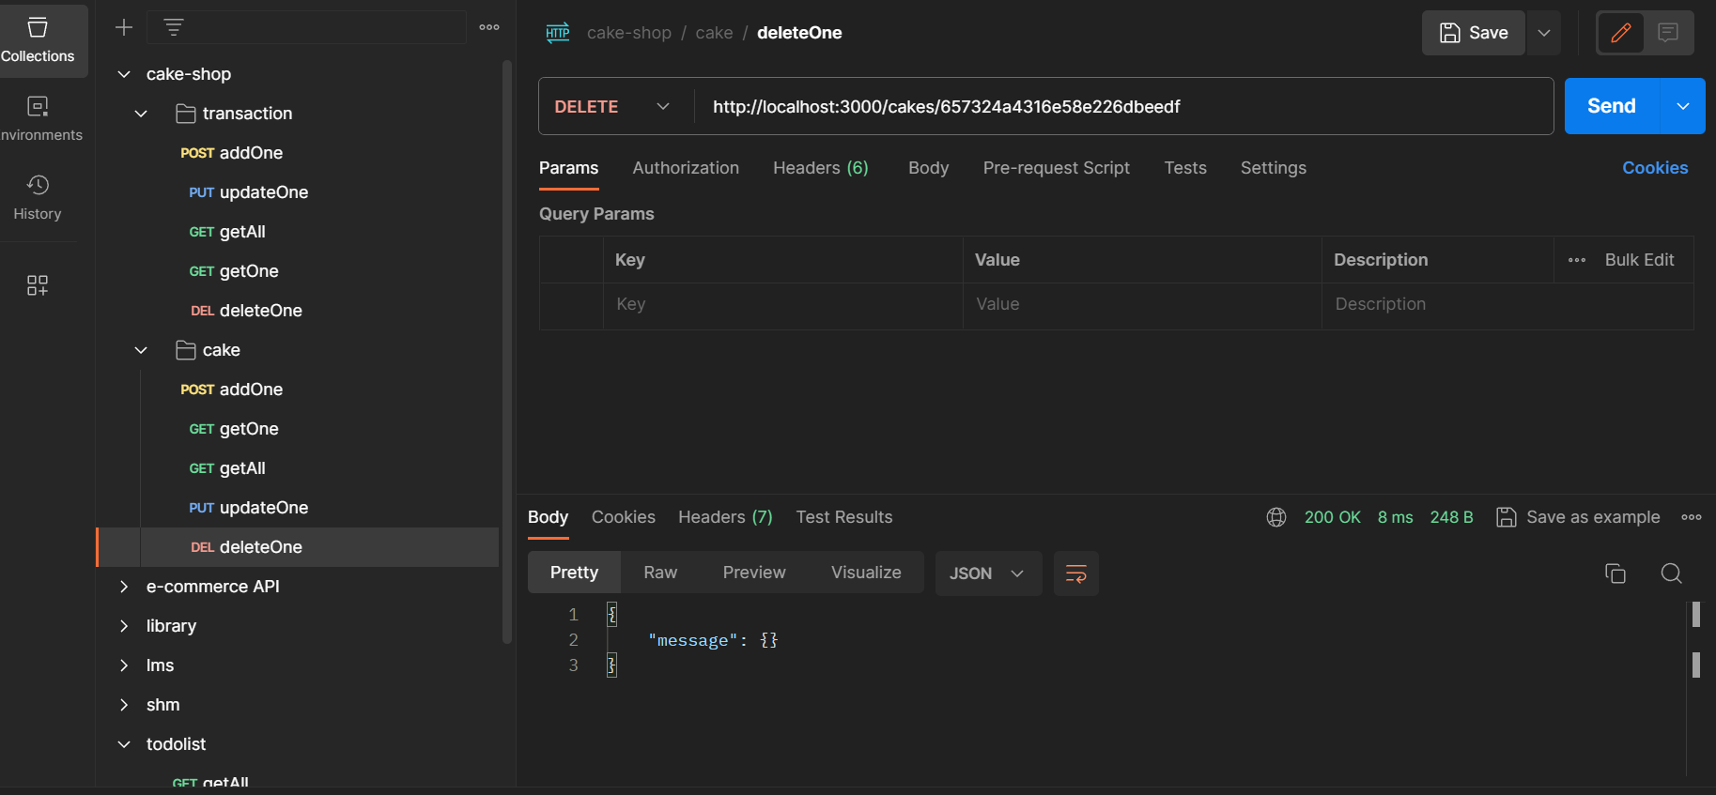
API TESTING DELETE ONE CAKE

Slide 16
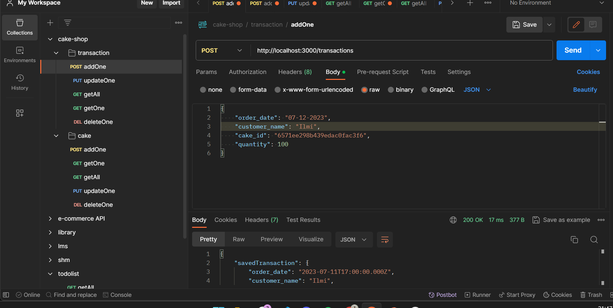
API TESTING ADD ONE TRANSACTION

Slide 17
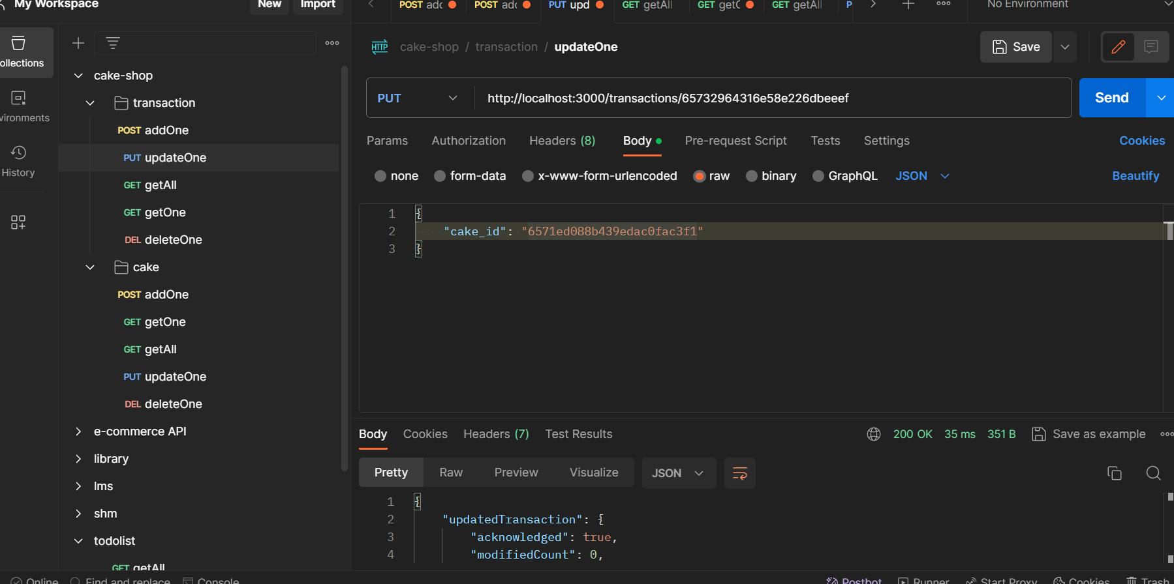
API TESTING UPDATE ONE CAKE

Slide 18
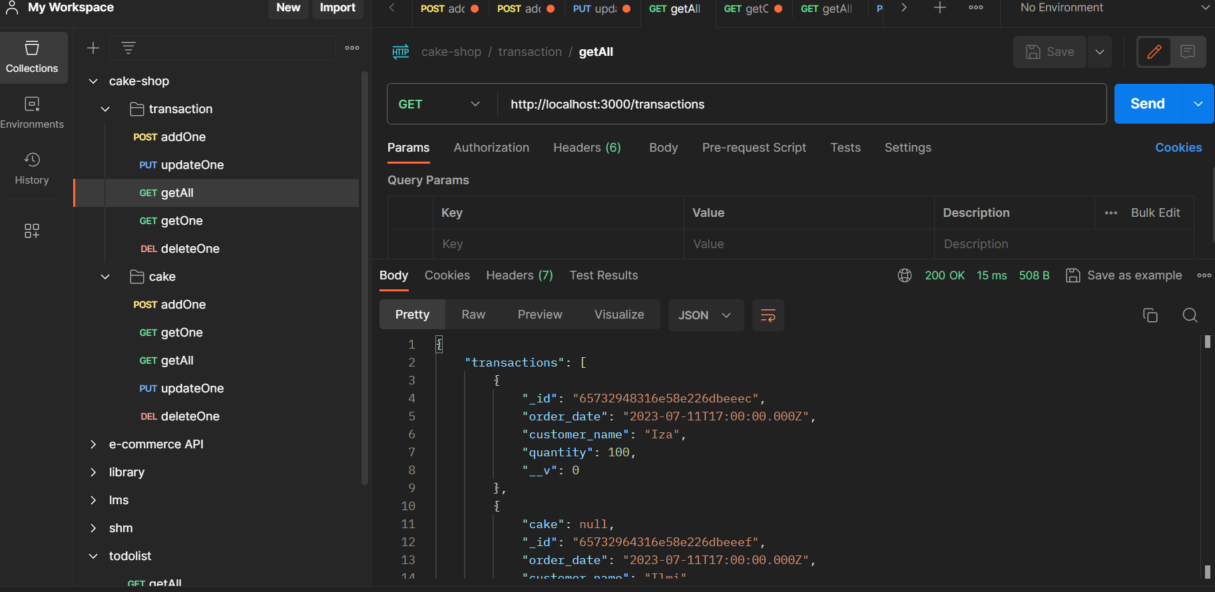
API TESTING GET ALL TRANSACTION

Slide 19
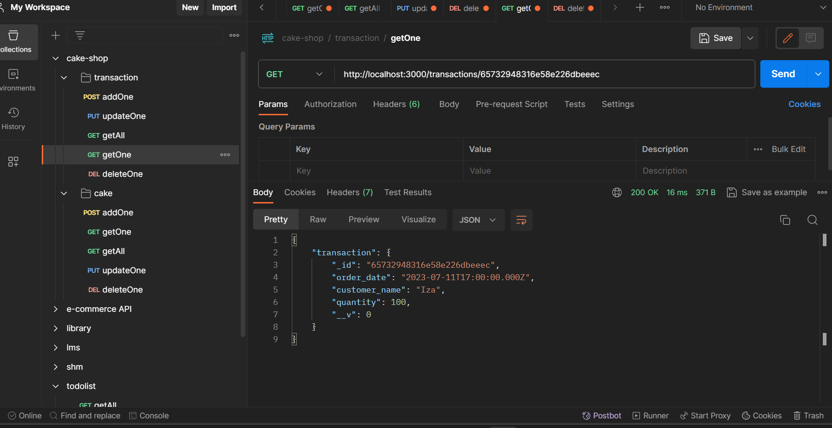
API TESTING GET ONE TRANSACTION

Slide 20
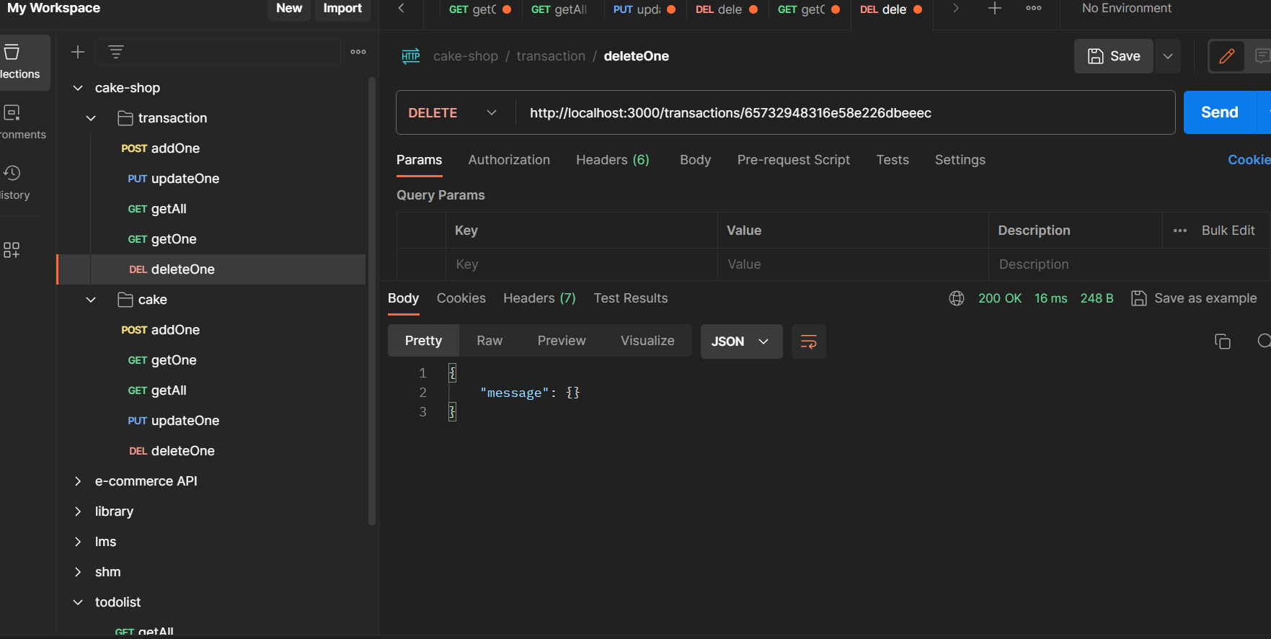
API TESTING DELETE ONE TRANSACTION

